Slide 1

PMI’s Global Vision
Bringing It Home to Nashville
Michael W. Strickland, MBA, PMP
PMI Region 14 Component Mentor

Slide 2
PMI’s Global Vision
Who are we and Why are we here?

Slide 3
Imagine ….
a world in which project management is as visible and recognized as other professions globally and in which project management is a unique competency in organizations.
PMI Today – July 2007

Slide 4
Why Are We Here?
In That World ….
all PMI members, as well as other project management practitioners and suppliers, will be recognized by their employers for their knowledge, skills and competencies, because…….
PMI Today – July 2007

Slide 5
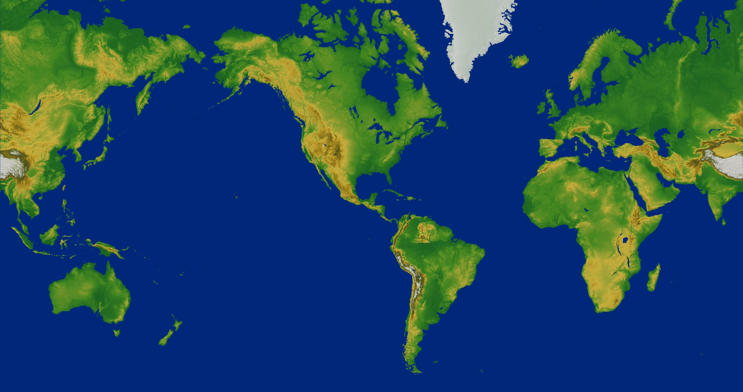
PMI’s Envisioned Goal
  Worldwide, organizations
  will embrace, value and
  utilize project management,
  and attribute their success to it.

Slide 6
PMI’s Global Vision
Who are we?

Slide 7
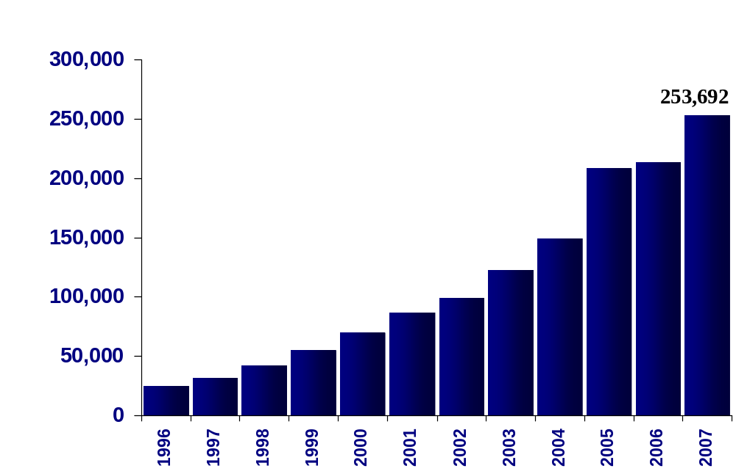
PMI® Membership Is Growing

Slide 8
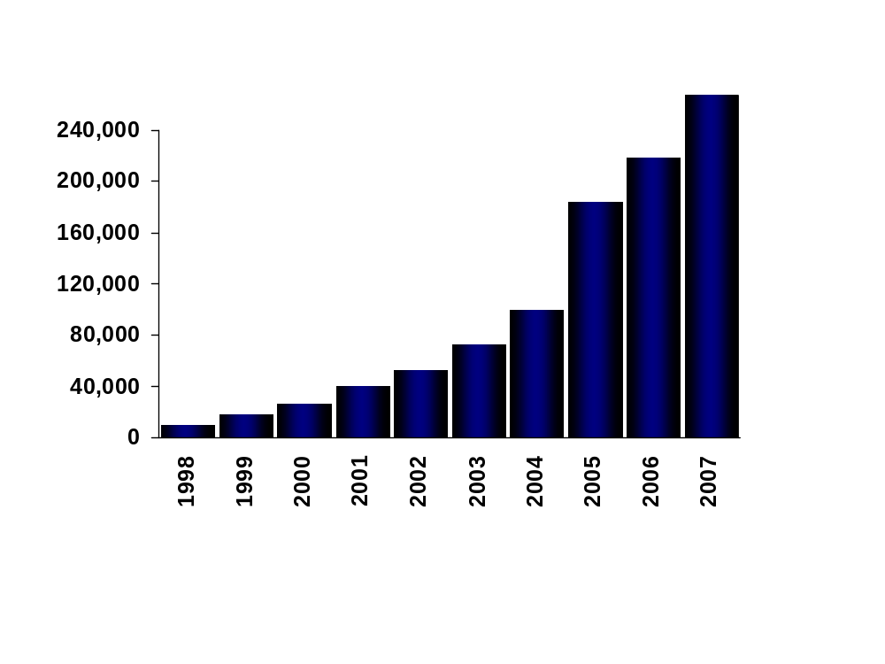
Growth in PMP® Certification

Slide 9

Regional Distribution of PMI Membership, PMP® and CAPM ® Certification
70% Membership
56% PMPs
63% CAPMs
12% Membership
10% PMPs
19% CAPMs
14% Membership
30% PMPs
15% CAPMs
4% Membership
4% PMPs
3% CAPMs
Based on March 2008 Data

Slide 10
PMI’s Global Vision
Why are we here?

Slide 11
“Making Project Management Indispensible for Business Results”
Through its Brand Promise, PMI aims to establish greater recognition of the value of the project management profession and its practitioners by the organizations that employ PMI members.
As it advocates for the profession and the Institute, PMI also focuses on helping organizations achieve their desired results.
Consequently, organizations will recognize the role of PMI members in attaining those results.
As more organizations recognize PM as a strategic competency, the profession will continue to grow.

Slide 12
What About Worldwide Economic Conditions?
“East meets West” Development Continues
Shrinking Economy – PM Needed Now More than Ever!
3288 Projects worth $2.8 trillion (PM Network, June 2008)
Explosive Growth! (esp. China)
Mega –Projects (e.g. Panama Canal Expansion)

Slide 13
PMI’s Global Vision
Where are we going?

Slide 14
PMI’s
CORE PURPOSE
To advance the practice, science and profession of project management throughout the world in a conscious and proactive manner.

Slide 15
Core Values
PROFESSIONALISM
KNOWLEDGE
■ Competence
■ Ethical behavior
■ Honesty
■ Sharing information
■ Thorough leadership
■ Standards-setting
■ Educational excellence
COMMUNITY & VOLUNTEERISM
■ Inclusiveness
■ Member participation
■ Constructive synergies
■ Openness with our stakeholders
■ Diversity
■ Consideration for all cultures
VALUE OF PROJECT MANAGEMENT
TO BUSINESS
■ Importance of business and government

Slide 16
Two Significant Goals envisioned in
PMI’s Strategic Plan
The Superior Practice of Project Management.
The Global Acceptance of Project Management.

Slide 17
Interrelated and not Mutually Exclusive
Superior Practice without Global Acceptance will prevent the profession from achieving its proper recognition.
Conversely, Global Acceptance without Superior Practice would result in the ultimate loss of value of the profession.

Slide 18
PMI’s Global Vision
How do we get there?

Slide 19
PMI’s Strategic Plan
The far-seeing Strategic Plan is helping to bring about these desired outcomes, and thus is performing its function as the foundation for change.
The PMI Strategic Plan is the instrument to set direction for that change and realize the envisioned future for the benefit of PMI members, practitioners, employing organizations and other stakeholders.

Slide 20
PMI Strategy Map With Balanced Scorecard Measures
Worldwide, organizations will embrace, value, and utilize project management and attribute their success to it.
Eminent Influence
Superior Practice of Project Management
Global Acceptance of Project Management
Strengthen stakeholder loyalty
Stakeholder Intimacy
Provide knowledge and tools with great service
Demonstrate benefits from project management
PMI Knowledge Strategy
Virtual Community
Value of PM Research
Stakeholders: Practitioners, Suppliers, Consumers
Thought Leadership
Profession Enablers
Partnering
Advocacy
Internal
Business
Processes
Provide the means to improve the practice of project management
Develop/enhance mutually advantageous and trusting relationships
Champion project management adoption and maturity
Facilitate innovative thinking and exchange of ideas
PMI Global Standards
PMI Research Program
Certification Program
Professional Development (Congresses)
REP Program
PMI Advocacy Program
Make PMI a customer centric organization
Make leadership excellence a strategic competency
Make market and business development a strategic competency
Culture and
Capabilities
Customer Care
Voice of the Customer
Leadership Institute
PMI Staff Leadership Program
M&BD Org Structure
Phase-Gate
Resources
Leverage resources/investment in the marketplace
Maintain financial viability
Usage of Non-Staff Resources
Reserve Policy
Investment Policy
Notes:
In support of the 12 balanced scorecard objectives, PMI has established 18 measures to either track or drive performance. As with objectives, there exists a cause and effect relationship among the measures of the balanced scorecard. As may be obvious, the measures of the Stakeholder Intimacy objectives are outcomes of progress made on those specific objectives as well as all the ones in the other perspectives.
Of particular note is PMI’s measure of Total Product Satisfaction – for its five primary revenue streams, PMI is measuring satisfaction at the transaction level (that is, at the time of purchase), at the delivery or usage level, and at the impact level (determined some time after delivery or usage to understand whether the product truly provided any value).

Slide 21
PMI Global Initiatives In Support of the Strategic Plan

Slide 22
Profession Enablers
Certification program
    PMP®
    CAPM®
    PgMP™
    PMI Scheduling Professional (PMI-SP)SM
    Risk Credential
        2008 launch

Slide 23
Profession Enablers
Standards Program
    A Guide to the Project Management Body of Knowledge (PMBOK® Guide)—Fourth Edition (Q4 2008)
    The Standard for Program Management — Second Edition (Q4 2008)
    The Standard for Portfolio Management — Second Edition (Q4 2008
    Organizational Project Management Maturity Model (OPM3®) — Second Edition (Q4 2008)
    Practice Standard for Project Estimation (Q4 2008)
    Practice Standard for Project Risk Management (2009)

Slide 24
Understanding the Value of Project Management: RESEARCH STUDY
Three-year multimillion dollar international research project with results from at least 60 case studies will be released in October 2008 at PMI Global Congress - North America:
  Definitively measure by qualitative and quantitative means the value of project management to organizations regardless of industry, size or geographic location.
  Define credible and defensible organizational measures of the value of project management practices.
  Obtain in-depth data on the methods, costs and benefits of project management implementation using multi-method approach of interviews, surveys and documentation reviews with organizations.

Slide 25
Other Global Initiatives
Membership Growth goal to 284,000 members this year, and to build our retention rate to exceed 75%.
Lapsed member telemarketing campaign: PMI in late 2007 contacted lapsed members via phone in North America. Based on initial results, over 50% of these contacts resulted in individuals who chose to renew their PMI and component memberships.
Chapter retention research and solutions: GOC contacted nearly 60 chapters and the component mentors around the globe to better understand why they have greater, or poorer, retention rates. Chapters with higher retention rates suggest that early involvement of their members improves retention at a local level.
Market segmentation: In the last two years, research and analysis were conducted to identify segments within PMI’s membership. We are in the process of developing plans to grow and retain these segments based upon what they value in their relationship with PMI.
Membership process improvements: A refreshed www.pmi.org went live in July 2007. Work continues on improving the online experience.

Slide 26
PMI Global Initiatives (continued)
Virtual Communities Project (VCP): an extension of the community transformation project. “One stop shop” is the idea conveyed that would drive members to come to PMI to get what they need, when they need it, easily and efficiently to solve problems within their work place and to advance their careers.
Community Leaders Survey sent to all PMI Component Leaders. Responses due 01 June 2008.
PMP Credential Renewal Date Change – August 2008. Months added to the current renewal cycle.

Slide 27
How Do We Bring These Initiatives to Nashville?

Slide 28
Alignment with PMI’s Strategic Plan and evaluation of our deliverables through the Performance Management Framework

Slide 29
PERFORMANCE Management Framework (PMF)
Designed to Promote Superior Service Delivery
Not Intended to Punish Components

Slide 30
Other Potential Names
Value Delivery Framework
Value Delivery Index
Index of Core and Extended Community Services
Member Value Framework
Service Delivery Framework
Member Value Model
Member Service Delivery Model

Slide 31
What is the PMF?
A tool to measure the value delivery to our members the Performance Management Framework describes services that communities should deliver to provide value
  Segmented into core services and extended services.
  Core services must be provided by the community
  Aligns with the PMI Strategic Plan
  Built from the Business Plan
  Extended services are additional services that a community can provide.
  Each Service has a measure and a minimum level the community should provide.

Slide 32
Why the PMF?
Normalize member value in all communities through Core Services
Ensure alignment of communities to PMI strategic plan
Means to ensure PMI communities deliver value to members
Focus communities on the key services that provide value to members
Focus efforts of GOC to support of components
Will be used for component awards

Slide 33
Community Core Services
Geographic Communities
  Community Events
  Web site
  Communications
  New member recognition
  Marketing Package
  Transitioning new leaders
  LIM Attendance
  Strategic Alignment
  Branch support
  Scorecard Report

Slide 34
Community Extended Services
Geographic Communities
  Community Meeting Roundtable Events
  Focus groups
  Best Practices
  Project of the Year
  Outreach to Industry
  Local Executive Events
  Outreach to university and colleges
  Presence (booth)at PMI Congress
  Sponsorship Management
  Resume postings
  Annual Report to Members

Slide 35
Multi-Year Operational Business Plan
INTRODUCTION
COMMUNITY PURPOSE
  Community Name
  Community Focus
  Community Value to Members
  Community Value to Volunteers
  Community Value to Other PMI Communities
  Community Value to PMI
  Objectives
COMMUNITY CHARACTERISTICS
  Organization
  Environment
  Key Stakeholders
  Considerations
THREE YEAR BUDGET
RISK PLAN
  COMMUNITY NAME

Slide 36
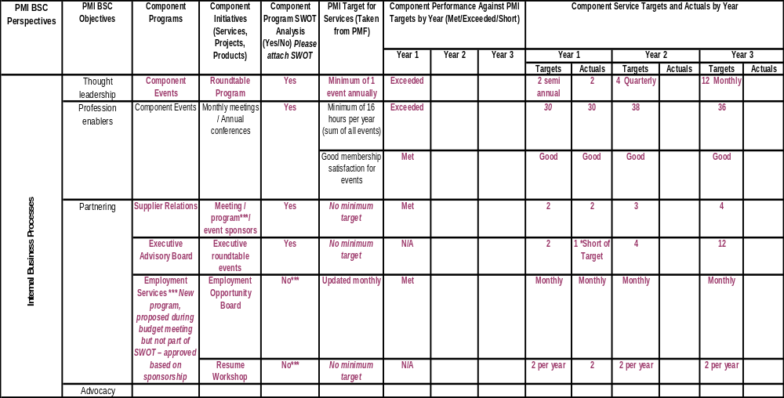
Strategic Alignment Worksheet
PMI Strategic Perspective: Internal Business Processes
Notes:
The report combines the Balanced Scorecard and Strategic Alignment Worksheet that previously existed as 2 separate templates.
Upon completion, it will depict how a component’s services align to PMI’s programs and objectives and measure against the targets for delivering member value.
It is also congruent with the Multi-Year Business Plan as it provides for future planning and targets for programs and activities.

Slide 37
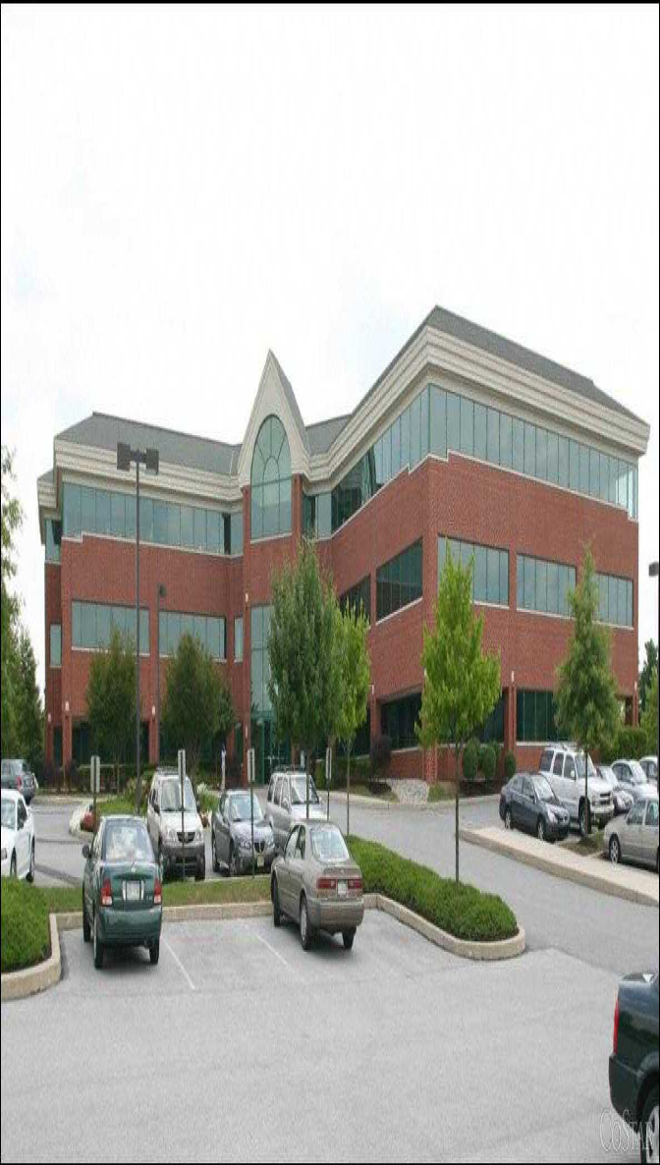
Who Will “Bring It Home” to Nashville?
PMI GLOBAL OPERATIONS CENTER
Building 14 Newtown Square, Pennsylvania
THEY CAN’T DO IT ALONE!

Slide 38

So Who Will ‘Bring It Home’?

Slide 39

Answer: We Must

Slide 40
So What Can You Do?
Support your Chapter Leadership in development of PMI Nashville Chapter’s Multi-Year Business Plan, Strategic Plan Update and completion of the Strategic Alignment/PMF Worksheet.
Volunteer for leadership opportunities! See www.pminashville.com for current opportunities.
Continue to expand PM education in the greater Nashville area, especially within local colleges and secondary schools.
Practice continuous learning in the project management profession. Enroll in PMI Learn and avail yourself of training provided by PMI’s R.E.P.’s.
Attend an upcoming PMI Global Congress to increase your knowledge of the worldwide practice of project management.
Aspire to attain a new PMI credential: PMP®, CAPM®, PgMP™, (PMI-SP)SM
Champion the superior practice of project management and global acceptance within your company and community.

Slide 41
What Role Will We Play ?
The Superior Practice of Project Management?
The Global Acceptance of Project Management?

Slide 42
PMI’s Envisioned Goal
  Worldwide, organizations
  will embrace, value and
  utilize project management,
  and attribute their success to it.

Slide 43
Imagine ….
a world in which you tell a stranger
that you are a project manager and
that person immediately understands your
role in achieving results—and is impressed
by who you are!
PMI Today – July 2007

